Slide 1
Advanced AB testing in practice
By: Eltsefon Mark

Slide 2
50/50 Split. What is the reason for other fraction?
Save more money if the experiment doesn’t go without the hinch
Mitigation the risks of the implementation
There are no clear constraints for comparing imbalance samples for statistical tests .
But what is about accuracy and power ?

Slide 3

50/50 . Power simulations
How to measure ?

Slide 4
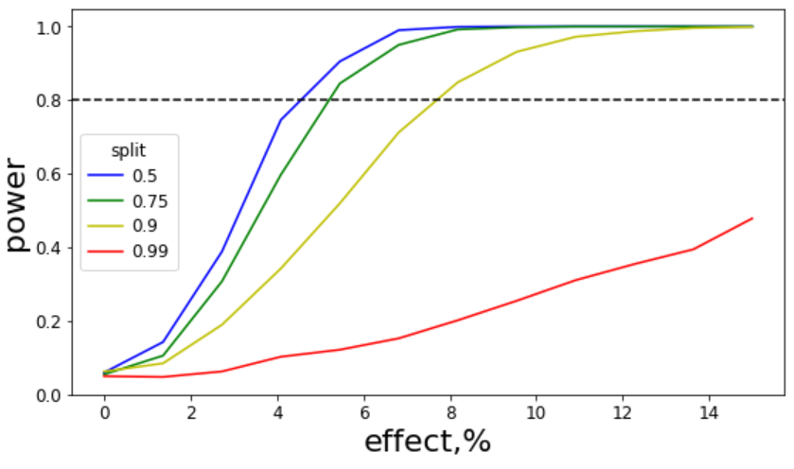
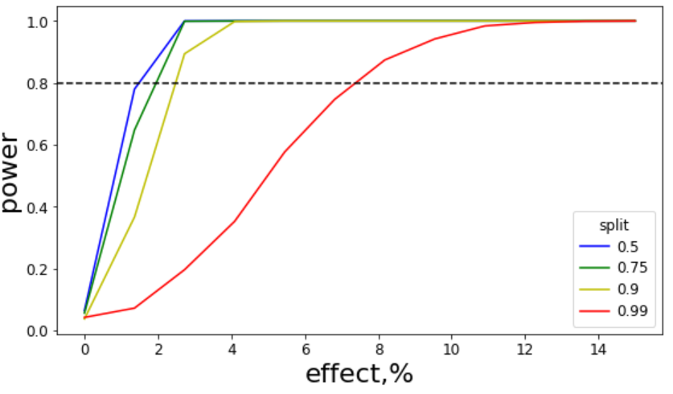
50/50 . Power simulations
n = 1000
n = 10000

Slide 5
50/50 . Conclusions
50/50
When to choose
There are no constraints from business
There are no risks implementing the feature
MDE is reasonable small
Other
When to choose
There are some severe constraints
There are imposing risks implementing the feature
We have enough traffic

